Slide 1

Terna Engineering College Computer Engineering Department Mini Project - Python ATM Simulation Using Tkinter
By
Yash Arjun Shrivastav TU2F1920072
Gopal Chandora TU2F1920098
Under the Guidance of : Nilesh Kulal

Slide 2
Index
Abstract
Introduction
Literature Survey
Problem Statement
Objectives
Scope
System Architecture
Tools
Implementation
Snapshots
Conclusion
References

Slide 3
Abstract
The ATM System is the project which is used to access their bank accounts in order to make cash withdrawals. Whenever the user needs to make cash withdraws, they can enter their PIN number (personal identification number) and it will display the amount to be withdrawn in the form of 100's and 500's. Once their withdrawn was successful, the amount will be debited in their account.
The ATM System is developed in Python. Python is the one of the powerful versions of object-oriented programming. Hence, we use this software in our project.
The ATM will service one customer at a time. A customer will be required to enter ATM Card, personal identification number (PIN) - both of which will be for validated as part of each transaction. The customer will then be able to perform one or more transactions. Also, customer must be able to make a balance inquiry of account linked to the card in a particular transaction.
If the database determines that the customer's PIN is invalid, then the 'Invalid PIN' message box will be showed the customer will be required to re-enter the PIN before a transaction can proceed.

Slide 4
Introduction
Automated Teller Machine enables the clients of a bank to have access to their account without going to the bank. This is achieved only by developing the application using online concepts. The ATM Simulation is an GUI based application using Python scripting language which gives user to perform various tasks as an ordinary ATM do such as withdrawal money, get updates of their account balance, account details, pin change and many more tasks. In this project we have performed only few features which are withdraw money, account detail, balance enquiry.
Python is a OOPs (Object Oriented programming) language. It is a HLL (higher level language) which one can easily understand and do coding, talking about availability it is open source as well as portable so we can use python in any OS (operating system). Python have a very huge collection of Library and modules which give varieties of coding ideas and from that one is GUI which is used in this project.
GUI (Graphical User Interface) is a module in python which provides a graphical interface to user which seems to be very interesting and user friendly also easy understand. GUI Contains widgets which make it interesting and attractive. There are several widgets in it some of them are (Label, Button, Entry, Frame, Geometry, etc.)

Slide 5
Literature Survey
By the 1960s, several teams around the world were working independently to devise a method for withdrawing cash from a bank after hours without committing a crime. The timeline for the advent and spread of the ATM is given below:
The first ATM was set up in June 1967 on a street in Enfield, London at a branch of Barclays bank. A British inventor named John Shepherd-Barron is credited with its invention. The machine allowed customers to withdraw a maximum of GBP10 at a time.
In the U.S., the deployment of the ATM was pioneered by Donald Wetzel, a Dallas-based engineer. The first ATM in the US was installed in September 1969 at the Chemical Bank branch in Rockville Center in New York with the slogan, “On September 2, our banks will open at 9 am and never close again.”
In 1970, a British engineer, James Good fellow, proposed the concept of a personal identification number (PIN), which automated verification of the identity of customers, thus marking a landmark moment in the growth of self-service banking.
The U.S. witnessed a major surge in ATM numbers in 1977 when Citibank pledged more than $100 million for the installation of the machines across the city of New York. ATM use rose by 20% when a blizzard forced all the banks in the city to close their branches for days.
In 1977, National Cash Register, a software and technology company in the U.S., launched the NCR Model 770, an easy-to-operate ATM that allowed the banks to offer services 24/7. The newer model (5070 ATM) launched in the early 1980s proved to be more reliable, flexible, and customer-friendly..

Slide 6
Problem Statement
To make a GUI (Tkinter) based ATM Simulation using python scripting might be difficult because we always got stuck at the implementation of widgets and which widgets will be better and where to placed it, also sometimes we got trouble to store data permanently, so to overcome with all this problem we make a simple version by just adding few functions and widgets which can decrement complexity.
User have to enter verification pin only at the starting stage of the transaction then user can do further transaction without verification pin this save the time and remove the headache of wrong pin entries messages. User only allows perform following transaction Withdraw money, check account balance, and account Statement.
Objectives
The aim of our mini project is to make a software program for “ATM Simulation” by using the versatile coding language “Python with GUI (Tkinter libraries)”.
To make a user friendly ATM and add new features which will beneficial in your day-to-day life and smooth it.

Slide 7
Scope
To implement the python programming in real life problem and make a positive use of the language which can benefits society. To clear all concept of GUI with python programming, we made an ATM Simulation program and developed our programming skills.
Millions of times per day around the globe people are instantly withdrawing money at automatic teller machines (ATMs). Given the fast-pace of the world today, it is not surprising that the demand for access to quick cash is so immense. The power of ATMs would not be possible without secure connections. The final act of ATM dispending cash is the result of an amazingly fast burst of the customer never sees, but a trust is being done in a confidential manner.

Slide 8
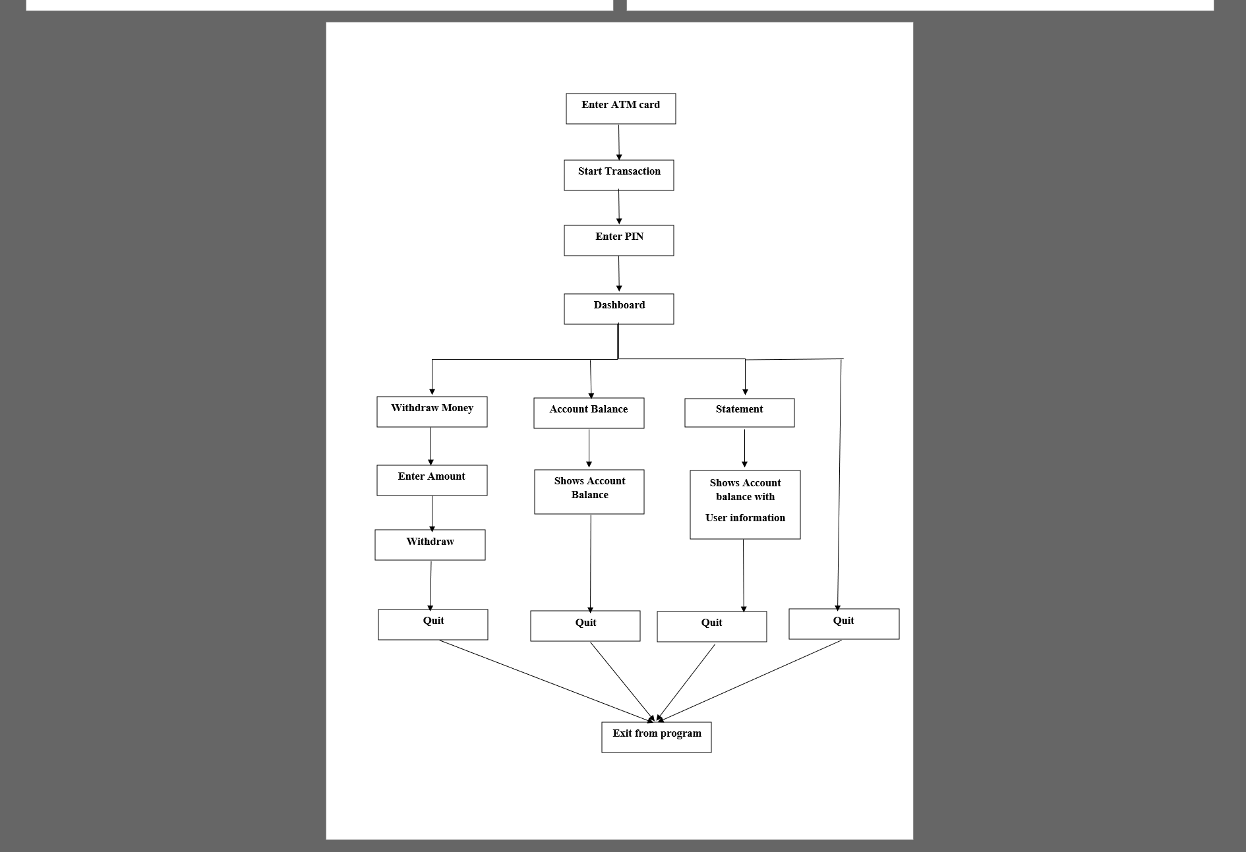
System architecture

Slide 9
Tools Required
Software Requirements:
PyCharm Software with GUI (Tkinter Libraries)
Hardware requirements:
RAM: 4GB or more,
Disk space :2.5 GB and another 1 GB for caches
Processor: Any Modern Processor
LCD Display
Mouse
Keyboard
Libraries
In this project three library are imported which are as follows:
From Tkinter import *
This line indicates Tkinter library for GUI to use basic widgets this line is important
From Tkinter import messagebox
This line is used for implementation of message box.

Slide 10
Implementation
The program begins with a window which contain some text and a button
Enter ATM card
If user clicks on the button, then it will be directed to new window where user will see a button Start Transaction.
After clicking the button, the user will see Transaction window where the user will enter a 4-digit verification pin, and have to click the button to enter in further windows
If the pin entered by user is incorrect then a message will popup showing “invalid pin” else, if the pin is correct then user will see a dashboard window.
In dashboard window there are 4 buttons
Withdraw
Account balance
Statement
Exit
If user clicked on Withdraw button, then again a new window will appear which contains a textbox, user will enter amount in it and a button to complete the task. It has following conditions which will display four different messages when user satisfied the format

Slide 11
If the user gives amount which is greater than available balance in the account then, a notification label will appear written with “Insufficient Balance”.
If user gives amount is not multiple of 100 then a notification label will appear written with “Amount should be multiple of 100”.
If the area is kept blank then “Amount is required” message will get notified.
If above conditions fails it means user entered correct amount which will display “Successfully Withdrawal with Remaining balance is: <remaining amount>”.
After successfully withdrawal there is a button named Exit for exiting.
If user clicked on Account Balanced, Account balanced window will get open where user can see their net balance and an Exit button for exiting the program.
If use clicked on Statement button, then Account Statement window get open in that user will have a detail of account showing name, account number and available balance and an Exit button for exiting the program.
If user clicked on Exit button the program will get exit.
Link for Code :- https://drive.google.com/file/d/1sBMD_EF942wtKB5czwi8oYBUrImGZWms/view?usp=sharing

Slide 12
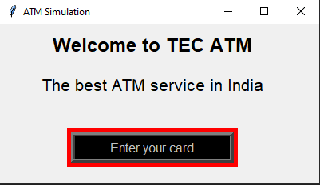
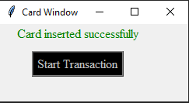
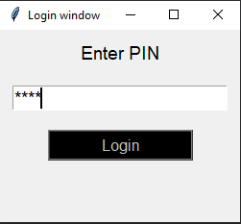
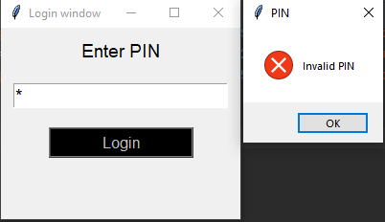
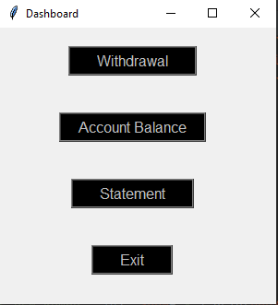
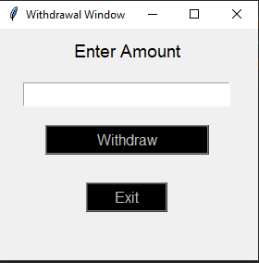
Snapshots
Main Screen
Card Window
Login Window
PIN is incorrect
Dashboard Window
Withdraw Window

Slide 13
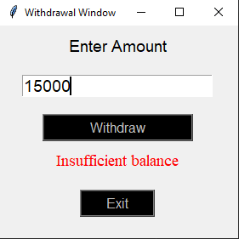
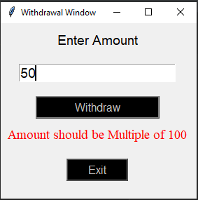
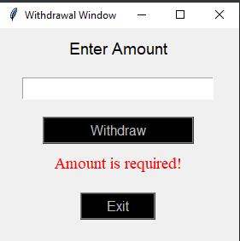
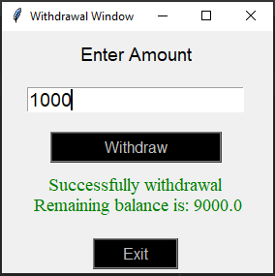
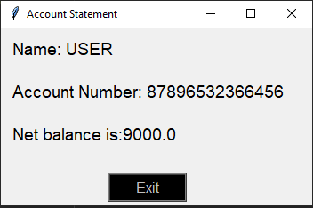
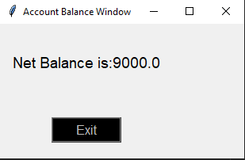
Withdraw Window
Statement Window
Account Balance Window

Slide 14
Conclusion
We believe that our design yields a simple and easy to use ATM (Automated Teller Machine) simulation. The user is prompted through the system at every step of the way with sufficient error checking to prevent invalid input, Also We have made the system UI as much user friendly as possible.
In this Report we have completed all the required instructions, problem statements, Libraries used, Functions used, Software and Hardware requirements after that we also covered the brief working of our system provided with the code of the program. We also inserted the screenshot of working of every function's window.

Slide 15
References
https://itsourcecode.com/free-projects/python-projects/atm-program-in-python-with-source-code/
https://www.youtube.com/watch?v=-Q4lm8eYulw&list=PLu0W_9lII9ajLcqRcj4PoEihkukF_OTzA

Slide 16
Thank You

